Slide 1


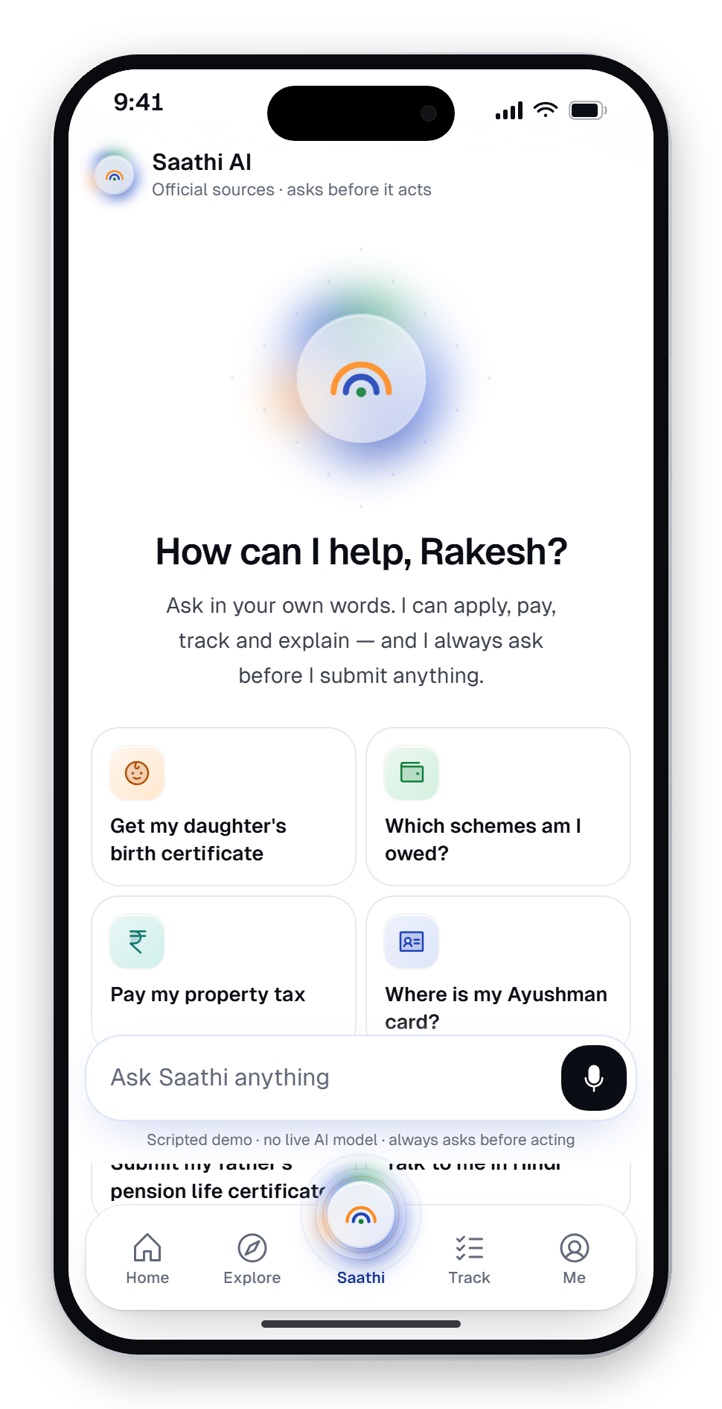
साथी
SAATHI
Minor Project · Phase 2
Project Scope & Literature Review
Smart City Citizen
Services App
Saathi — one door to every government service. A multilingual, voice-first citizen app with an assistant that asks before it acts.
SUBMITTED BY
DEPARTMENT
Krishom Sharma
UIC
BCA (UI/UX Designs)
University Institute of Computing
UID — 24BCU10002
A design concept. Not affiliated with the Government of India.

Slide 2
What this phase covers
Phase 2 draws the boundary of the project and grounds it in standards, platforms and research.
01
Scope at a glance
07
Standards & policy
What is in, what is deliberately out
WCAG, GIGW, UX4G, DPDP Act
02
Functional scope
08
Platforms & existing apps
Eight modules of the app and console
India Stack and UMANG
03
Service scope
09
Global benchmarks
Fifteen city departments behind one door
GOV.UK, LifeSG, Diia and more
04
User & language scope
10
HCI & AI literature
17 languages, 8 accessibility modes
Heuristics, HCD and human-AI guidelines
05
Technical scope
11
Gaps → implications
Stack, architecture and conceptual integrations
What the review means for the design
06
Constraints
12
References
Legal and ethical non-negotiables
Sources cited in this phase

Slide 3




Scope at a glance
A complete, working design concept — with real integrations deliberately left out of a student prototype.
In scope
Out of scope (for now)
Citizen mobile app: onboarding, Home, Explore, Saathi AI, Track, Me
Live Aadhaar authentication and real payments
42 government processes modelled on their real portals
Live speech recognition in every language
Scripted AI assistant with plan, consent and outcome
A live language model — the assistant is scripted and reviewable
15 department consoles — the officer's side of each service
Offline-first data layer and real department back-ends
17 languages live, voice entry and accessibility modes
Native-speaker sign-off for the 13 machine-assisted languages
Design system, website and editorial case study
Every integration is labelled “conceptual” and all data is sample data.

Slide 4








Functional scope
Eight modules, every one built and clickable in the prototype.
Onboarding
Home
Explore
Saathi AI
10 steps: language, Aadhaar, OTP, consent, profile, accessibility
Identity card, needs-attention nudges, applications, schemes for you
Life moments, services and schemes — plus on-device search
Ask in any words; it plans, shows sources, asks, then acts
Apply engine
Track
Me & privacy
Dept. consoles
42 flows: progress, voice fill, documents, review, receipt
Timeline with stages, named officers, SLAs and dates
Document wallet, family proxy, consent and access log
15 desks that review, verify and decide — live to the citizen

Slide 5















Fifteen city departments, one door
Each service in the app has a desk on the other side — a department console for officers in Kanpur.
Municipal Corporation
Revenue
Aadhaar Regional Office
Transport
Health
Nagar Nigam
Tehsil Sadar
Lucknow
RTO · UP-78
District Health Society
Education
Examinations
Agriculture
Rural Development
Labour & Skills
District Education Office
NTA, Board & SSC
District Agriculture Office
Block Office, Kalyanpur
Labour Office
Women & Child Dev.
Social Welfare
Banking & Inclusion
Income Tax
Public Grievances
District Programme Office
District Welfare Office
Lead District Office
Ward 2(1), Kanpur
District Grievance Cell
Officer side in scope: review applications, masked e-KYC with a stated purpose, signed records to DigiLocker, challans, exams and benefit transfers — with an audit trail that can't be edited.

Slide 6








Built for every Indian
User scope covers literacy, age, ability, bandwidth and language — not just the urban, English-first user.
“HOW CAN I HELP?” — IN EIGHT OF 17 LIVE LANGUAGES
ACCESSIBILITY MODES IN SCOPE
मैं कैसे मदद करूँ?
Hindi
Voice on every field
Read aloud
আমি কীভাবে সাহায্য করতে পারি?
Bengali
நான் எப்படி உதவலாம்?
Tamil
Slow mode
Larger text
నేను ఎలా సహాయం చేయగలను?
Telugu
હું કેવી રીતે મદદ કરી શકું?
Gujarati
Family / proxy mode
Weak-signal ready
ನಾನು ಹೇಗೆ ಸಹಾಯ ಮಾಡಲಿ?
Kannada
ഞാൻ എങ്ങനെ സഹായിക്കാം?
Malayalam
ਮੈਂ ਕਿਵੇਂ ਮਦਦ ਕਰ ਸਕਦਾ ਹਾਂ?
Punjabi
Colour-blind safe
Screen-reader ready
Hindi, Bengali and Tamil fully authored · 13 machine-assisted, marked for native review · 6 coming soon

Slide 7




Technical scope
A static, fast, testable web build — the prototype runs in any browser, no install.
Experience
Next.js 14 (App Router) · React 18 · TypeScript · Tailwind CSS · Framer Motion · Phosphor Icons
CONCEPTUAL INTEGRATIONS
Aadhaar
Proves it's you
Language
next-intl · 23 locale folders (English + 22 Eighth Schedule) · per-script fonts & line-heights
DigiLocker
Brings verified documents
UPI
Pays fees and dues
Logic
Scripted agent engine (intents → missions → player) · prototype state context · Vitest unit tests
Bhashini
Speaks your language
API Setu
Talks to departments
Delivery
Static export · Hostinger web hosting · Lighthouse budget ≥ 90 performance / ≥ 95 accessibility
CPGRAMS
Escalates complaints
Saathi is not affiliated with these platforms.

Slide 8





Constraints we design within
Non-negotiables for trust, law and a jury-ready submission.
No State Emblem of India
No maps of India
Protected by the State Emblem of India (Prohibition of Improper Use) Act, 2005. Saathi uses its own mark — two arcs and a point from the tricolour.
A mis-drawn border is a disqualification-grade error. Imagery avoids maps entirely.
No stock people, no fake testimonials
A visible disclaimer, everywhere
Personas are clearly personas, shown as typographic monograms.
“A design concept. Not affiliated with the Government of India.”
Honest claims
Consent before data moves
“Designed to” WCAG 2.1 AA, GIGW 3.0, UX4G — never “certified”. Impact numbers are design targets.
Shaped by the Digital Personal Data Protection Act, 2023: who, what, why, until when.

Slide 9




Four lenses of review
The literature review looks at what governs, what exists, what leads and what research says.
Standards & law
Indian platforms
Global benchmarks
HCI & AI research
WCAG 2.1 · GIGW 3.0 · UX4G · DPDP Act 2023 · Smart Cities Mission
India Stack rails and UMANG, the government's own unified app
GOV.UK · Singapore LifeSG · Ukraine Diia · Estonia · UAE Pass
Usability heuristics · human-centred design · human-AI interaction
What the design must comply with
What already exists to build on
What world-class civic design looks like
What research says about people and AI

Slide 10
Standards & policy
What each source asks of the design — and how Saathi answers.
Source | Key requirement | Applied in Saathi
WCAG 2.1 AA (W3C, 2018) | Contrast ≥ 4.5:1, text resize, keyboard & screen-reader access | Every colour pair tested in code; larger-text & screen-reader modes
GIGW 3.0 (MeitY, 2023) | Guidelines for Indian Government Websites and apps | Bilingual gov strip, official-site guidance, accessibility toolbar
UX4G (NeGD, MeitY) | Design system for Indian e-gov; Noto Sans, Indic legibility | Noto Sans Indic body at 1.8 line-height; 16 px minimum body
DPDP Act, 2023 | Purpose-bound, informed, revocable consent for personal data | Consent cards (who, what, why, until when) + privacy dashboard
Smart Cities Mission (MoHUA, 2015) | Citizen-centric, technology-enabled urban services | Municipal, mobility, health and grievance services in one app
State Emblem Act, 2005 | Prohibits improper use of the national emblem | Own brand mark; disclaimer on every page

Slide 11




India Stack — the rails
Saathi is designed as a front door on top of India's digital public infrastructure — built on it, not beside it.
Aadhaar
DigiLocker
UPI
UIDAI · 2010
MeitY · 2015
NPCI · 2016
Verifiable digital identity for every resident
Issued documents on the phone
Instant, interoperable payments
→ e-KYC at onboarding; masked by default
→ Pre-fills applications; wallet cards
→ Property tax, fees and challans
Bhashini
API Setu
CPGRAMS
MeitY · 2022
MeitY
DARPG
Language technology for Indian languages
Open APIs between departments
Centralised public grievance system
→ Voice and translation across 22 languages
→ How consoles exchange records
→ Escalate a delay with context filled in

Slide 12
UMANG — and where Saathi differs
UMANG proved aggregation is possible. Saathi asks how it feels for a real person to use one service.
Aspect | UMANG | Saathi
Organising idea | A directory of departments — you must know the service's name | Life moments, needs and entitlements — start from your situation
Language | 13 languages, but most forms fall back to English | Vernacular-first, voice on every field, script swaps in 200 ms
Discovery | You search — nothing tells you what you're owed | Profile-based scheme cards with “why you qualify”
Trust & calm | Official, but visually dense and utilitarian | Calm authority — verification and status in the first five seconds
Help & status | Largely on your own once you submit | Timeline with named officers; family proxy is first-class
Accessibility | Little for low-literacy or low-vision users | Slow mode, larger text, read-aloud, weak-signal design
UMANG is a real, large-scale product serving millions. This comparison is about design philosophy — not a critique of its engineering or reach.

Slide 13
Global benchmarks
The best civic products in the world, and the one lesson Saathi takes from each.
GOV.UK Design System
LifeSG
Diia
UNITED KINGDOM
SINGAPORE
UKRAINE
Ruthless clarity, plain language, one thing per page, accessible defaults.
Services organised around life moments — validates Saathi's core frame.
A confident state brand and pastel document cards people are proud of.
e-Estonia
UAE Pass
KRDS
ESTONIA
UNITED ARAB EMIRATES
SOUTH KOREA
Data transparency: citizens can see who looked at their records.
Digital identity as a first-class object across every service.
A national design system shared by every government service.
Saathi combines them: GOV.UK's clarity + LifeSG's life moments + Diia's document cards + Estonia's access log — in India's languages.

Slide 14
What research says
Foundational HCI and human-AI literature that shaped the design decisions.
Author / work | Key idea | Design decision in Saathi
Nielsen (1994) — 10 Usability Heuristics | Visibility of system status; match the real world; error prevention | Status is sacred: live timelines; plain words; drafts never lost
Norman (2013) — The Design of Everyday Things | Affordances, signifiers, feedback and mapping | Big tap targets, explicit labels, receipts after every action
ISO 9241-210:2019 — Human-centred design | Design from users' context, iterate with evaluation | Personas from field conversations; validation plan per persona
Design Council (2005) — Double Diamond | Diverge, then converge — on the problem, then on the solution | Project phases: identify → scope → plan → design → validate
Amershi et al. (CHI 2019) — Guidelines for Human-AI Interaction | Make clear what AI can do; support correction and dismissal | Plan card, sources named, Approve / Edit / Cancel, stop button
Shneiderman (2022) — Human-Centered AI | High automation with high human control | Agent acts only after consent; a person is always one tap away

Slide 15

Gaps → design implications
What the review revealed, and how each gap became a decision.
GAP IN EXISTING SOLUTIONS
SAATHI'S RESPONSE
Services organised by department, not by life
Three lenses: moments, needs, entitlements
Forms fall back to English; no voice
Vernacular-first + voice on every field, 17 languages
No way to tell real portals from fakes
Trust in 5 seconds: verification, sources, verifiable receipts
Chatbots answer, but don't act
An agent that plans, asks consent, then does the paperwork
Citizens can't see who used their data
Privacy dashboard: access log and one-tap revoke
Officer side invisible to citizens
Department consoles — decisions reach the citizen live

Slide 16
References
[1]
W3C (2018). Web Content Accessibility Guidelines (WCAG) 2.1. World Wide Web Consortium.
[8]
Norman, D. (2013). The Design of Everyday Things (Revised & expanded ed.). Basic Books.
[2]
MeitY (2023). Guidelines for Indian Government Websites and Apps (GIGW 3.0). Government of India.
[9]
ISO 9241-210:2019. Ergonomics of human-system interaction — Human-centred design for interactive systems.
[3]
NeGD, MeitY. UX4G — User Experience for Government design system. Government of India.
[10]
Design Council (2005). The Double Diamond design process model. London.
[4]
Government of India (2023). The Digital Personal Data Protection Act, 2023.
[11]
Amershi, S. et al. (2019). Guidelines for Human-AI Interaction. Proc. CHI '19, ACM.
[5]
Government of India (2005). The State Emblem of India (Prohibition of Improper Use) Act, 2005.
[12]
Shneiderman, B. (2022). Human-Centered AI. Oxford University Press.
[6]
MoHUA (2015). Smart Cities Mission — Mission Statement & Guidelines. Government of India.
[13]
GOV.UK Design System; Singapore LifeSG; Ukraine Diia — public product documentation.
[7]
Nielsen, J. (1994). Enhancing the explanatory power of usability heuristics. Proc. CHI '94, ACM.
[14]
NPCI (2026). UPI product statistics; UIDAI Aadhaar dashboard; DigiLocker statistics.

Slide 17

Thank you.
Phase 2 fixed the boundary of the project and grounded every decision in standards, platforms and research.
NEXT · PHASE 3
Planning, budgeting, task definition and preliminary design: timeline, costs, work breakdown, information architecture and first screens.
Krishom Sharma · BCA (UI/UX Designs) · UID 24BCU10002

